Slide 2
Unified Approach
author Ali Bahrami (1999).
based on methodologies by Booch, Rumbaugh, and Jacobson

Slide 3
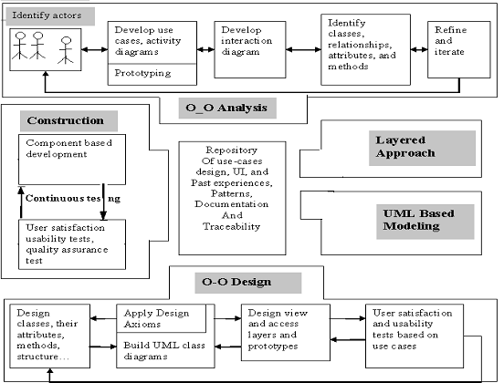

Slide 4
The processes are:
1. Use-case driven development
2. Object-oriented analysis
3. Object-oriented design
4. Incremental development and prototyping
5. Continuous testing

Slide 5
OOA process consists of the following steps:
1. Identify the Actors.
2. Develop a simple business process model using UML Activity diagram.
3. Develop the Use Case.
4. Develop interaction diagrams.
5. Identify classes.

Slide 6
OOD Process consists of:
1. Designing classes, their attributes, methods, associations, structures and protocols, apply design axioms.
2. Design the Access Layer
3. Design and prototype User interface
4. User Satisfaction and Usability Tests based on the Usage/Use Cases
5. Iterated and refine the design

Slide 7
iii. Iterative Development and Continuous Testing

